Slide 1

Note app
Desinged by Mohamed Raafet, Seif Eleslam, Eslam Saed, Abdelrahman Ashraf, Omar Ayman, Ahmed Raof

Slide 2
intro
Take note of almost anything

Slide 3

abstract
Notes is the best place to jot down quick thoughts or to save longer notes filled with checklists, images, web links, scanned documents, handwritten notes, or sketches.

Slide 4
01
Project definition
small tour in the app

Slide 5

Splash
Our project first starts with a splash screen that stays around 3 second.

Slide 6
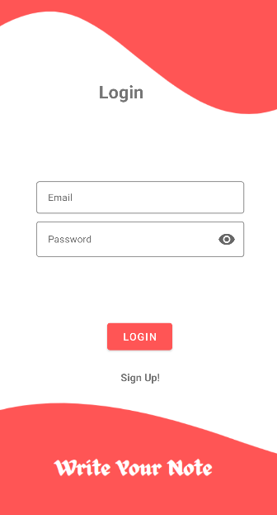
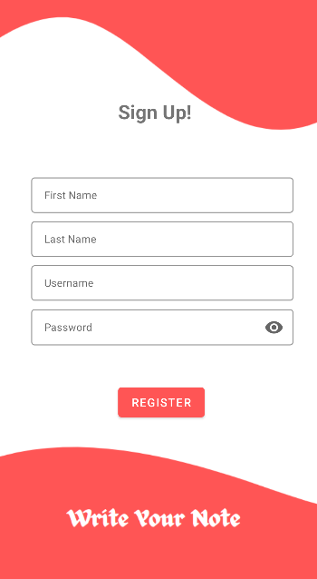
Login & SignUp
then we move to the second layout which is the login page. The user can enter his email and password or he can sign Up

Slide 7
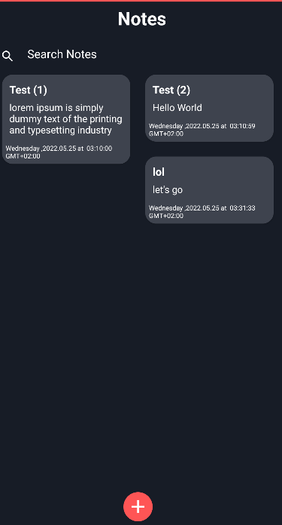
Main
The main page that users can manage his note such as add, delete or edit his note

Slide 8
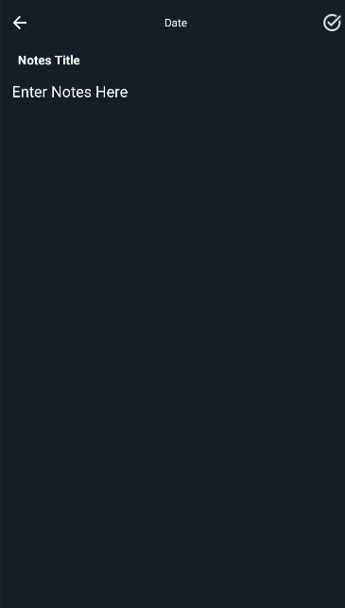
Add note
If the user wants to add a note he can click on the button and then move to that page

Slide 9
Code snippet
02
an abstract of the functions and classes

Slide 10
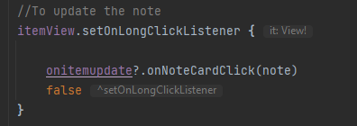
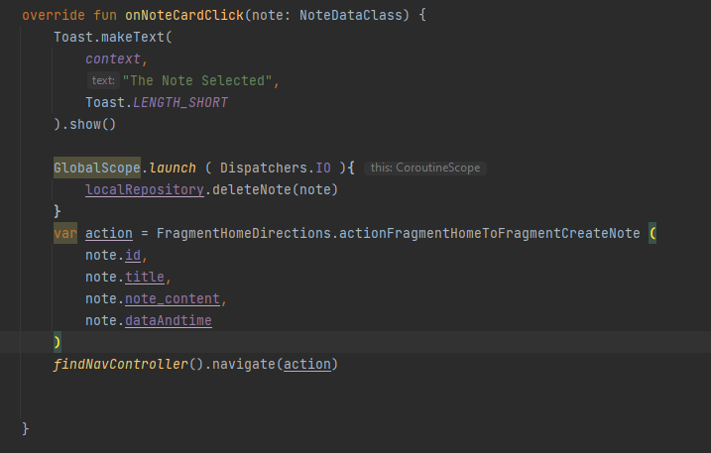
edit
This edit function work when click on the note

Slide 11
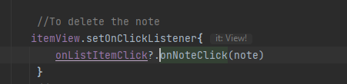
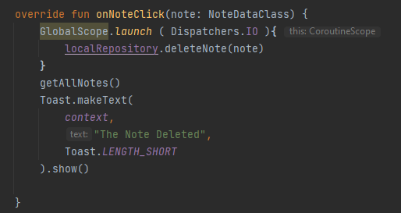
delete
Work when long click on the note

Slide 12
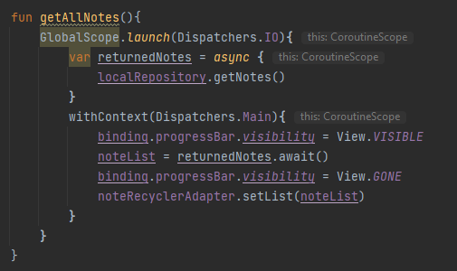
Get note
This function that get list of note

Slide 13
Features
03
discussing app features

Slide 14
features
01
02
03
attachments
searching
Date
04
05
edit
delete
Add attachments – photos, maps, web links, documents and more.
Search for text in notes, your handwriting, and titles
Every note is added with the date is created on
You can edit your note and it will update also the date automatically
You can delete your note

Slide 15
Thanks
Under supervision: Eng./Ahmed Twafik

